Slide 1
Russia’s Ambitions strikes fear in NATO generals

Slide 2
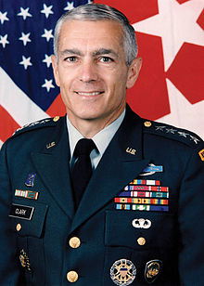
NATO won't surrender if Russia nukes Warsaw – ex-US Supreme Commander RT News May 7, 2016
“Putin-dominated” Russia is mistaken if it expects the US to surrender in a hypothetical conflict after Moscow nukes "say, Warsaw," a former NATO Supreme Allied Commander for Europe told CNN, promising retaliatory measures.
They are using nuclear weapons in their military exercise as a means of deescalating a conflict, as though they could fire a nuclear weapon at, say, Warsaw, and then NATO would say, “Oh, my goodness, we did not know you really mean it,” the former NATO commander said.
His opinion comes in unison with fears of Polish Foreign Minister Witold Waszczykowski, who said last month that “Russia’s activity is a sort of existential threat because this activity can destroy countries.”

Slide 3
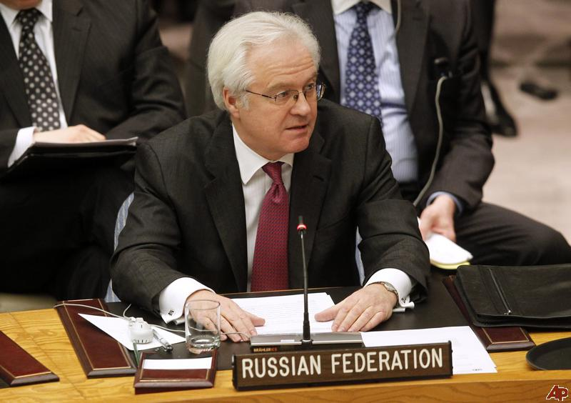
Rising terror threat casts doubt on US-led coalition’s effectiveness in Iraq – Russia’s UN envoy RT News May 7, 2016
Russia’s UN envoy has questioned the effectivity of the US-led counter-terror operation in Iraq, as terrorist activity has intensified there. He also urged the UN to delve into the origin of chemical agents obtained by militants “via Turkey.”
Speaking at Friday’s UN Security Council meeting on Iraq, Russia’s Ambassador to the UN, Vitaly Churkin, commended the Iraqi government’s efforts in combatting Islamic State (IS, formerly ISIS/ISIL), while questioning the role of the international coalition under the leadership of US forces, which he said has not achieved any feasible progress on the ground so far.

Slide 4
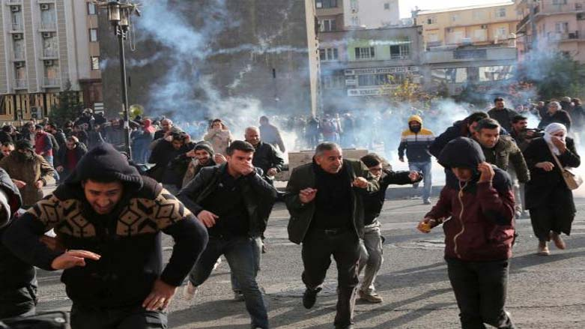
Rising terror threat casts doubt on US-led coalition’s effectiveness in Iraq – Russia’s UN envoy RT News May 7, 2016
“…The dramatic rise in terrorist activity, especially in Bagdad, makes us grow wary and question the efficiency of the activities of the ‘coalition’ which has been calling itself ‘global’ in the recent time due to some reason,” he said, pointing out the rapid expansion of Islamic State’s operations in Libya, Afghanistan, and Europe.
“There should be no room for double standards. All responsible members of the international community must follow a consistent and principled line in countering this absolute evil,” he said.
“Poisonous warfare substances are rapidly spreading across the region and are used by terrorists, but some member-states are consistent in turning a blind eye on that,” he stressed, noting that research into the components of the explosive mixtures recovered from terrorists near the Iraqi city of Tikrit, as well as further investigation into their producers and import conditions, indicate that they came from Turkey.

Slide 5
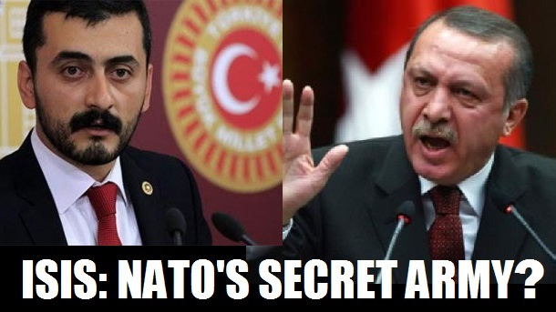
Mafia State: Turkish MP Now Faces ‘Treason’ Charges For Revealing How ISIS Used Turkey For Smuggling Chemical Weapons Dec 16,2015 21st Century Wire
A Turkish MP has been charged with treason today after alleging in an exclusive interview with RT that ISIS terrorists had smuggled deadly sarin nerve gas into Syria from Turkey.
Ankara’s Chief Prosecutor’s Office opened a case against Istanbul MP Eren Erdem, a member of the Republican People’s Party (CHP) after a TV interview which aired on RT on Monday.
This comes on the heals of massive international pressure on Turkish leader Recep Tayyip Erdoğan who has already been indirectly implicated for the role his government and military have played in facilitating terrorist operations in Syria and Northern Iraq.

Slide 6
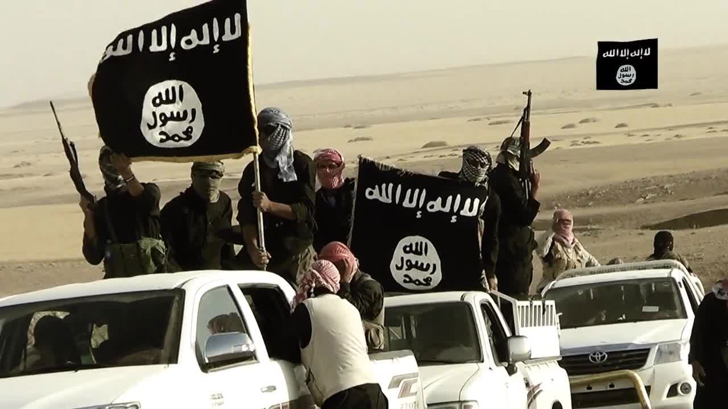
Iraq leans toward Russia in war on Islamic State Reuters Oct 7, 2015
Iraq may request Russian air strikes against Islamic State on its soil soon and wants Moscow to have a bigger role than the United States in the war against the militant group, the head of parliament's defense and security committee said on Wednesday.
“In the upcoming few days or weeks, I think Iraq will be forced to ask Russia to launch air strikes, and that depends on their success in Syria," Hakim al-Zamili, a leading Shi'ite politician, told Reuters in an interview.
The comments were the clearest signal yet that Baghdad intends to lean on Russia in the war on Islamic State after U.S.-led coalition airstrikes produced limited results.

Slide 7
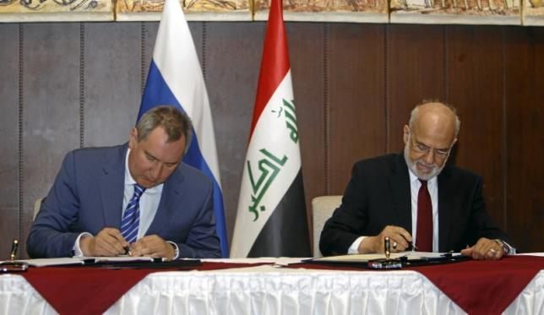
Russia boosts ties with Iraq in challenge to U.S. influence Reuters Feb 11, 2016
Russia is ready to sell civil airliners to Iraq and keep providing it with military aid to fight Islamic State, Deputy Prime Minister Dmitry Rogozin said on Thursday, accompanied on a trip to Baghdad by the biggest Russian delegation in years.
Iraqi Foreign Minister Ibrahim al-Jaafari said discussions had revolved around providing military assistance to defeat Islamic State militants, also known as Daesh, who seized a third of Iraq in 2014 and want to redraw the map of the Middle East.
"We need international support from multiple sources, be it from within the international coalition or outside of it," he said, referring to the U.S.-led coalition which has launched thousands of airstrikes and provided training and advice to Iraq's military.
"We need support, training and intelligence-sharing," he told reporters. "Intelligence plays an important role in the war on Daesh, and we've been coordinating for a while now with the Russian side to place this information in the hands of Iraqis."

